Slide 1



ATlIQ MART’S FESTIVE PROMOTIONS AND ITS IMPACT ANALYSIS
Presented By
Tania Das
AKA Peter Pandey

Slide 2






AGENDA
PROBLEM STATEMENT
DATA WALKTHROUGH
AD-HOC REQUESTS AND IT’S SOLUTIONS
UNDERSTANDING THE KPI’S
POWER BI DASHBOARD
RECOMMENDATIONS AND INSIGHTS

Slide 3
PROBLEM STATEMENT
AtliQ Mart, a retail giant with over 50 supermarkets in the southern region of India is looking to analyse the effectiveness of their promotions during specific festive seasons in India.
The sales director Bruce Haryali aim to understand which promotions were successful and which were not to make informed decisions for future promotional periods.
The analytics manager Tony delegates this analysis task to Peter Pandey, a curious data analyst at AtliQ Mart.

Slide 4
DATA WALKTHROUGH
The data model consists of 4 main tables:
dim_products
dim_stores
dim_campaigns
fact_events
dim_products:- This table consists of all the necessary information about the products . It includes product id, product name (specific description), category of product.
dim_stores:- This table consists of the information of stores of Atliq located in different cities where Atliq has its supermarket.
dim_campaigns:- This table gives us the idea about the promotion campaigns being run by Atliq in their supermarkets.
fact_events:- It gives information about unique sales event of Atliq supermarket . Each record gives the info about product id , store id, base price, promo offer applied on it , as well as quantity sold before & after promotion.

Slide 5
UNDERSTANDING THE KPIs
KPI’S are key performance indicators. It is an important metric which helps us to track progress of our specific goal or objective.
Very important insights can be derived from this KPI’s to drive our business in more better way.
The important KPI’S which we have used to gain insights of the sales performance of Atliq by different promotion campaigns are as follows
Revenue After Promotion:- It can be defined as the revenue generated by Atliq sales after the application of promotion campaigns which are Diwali 2023 & Sankranti 2024.
Formula: Quantity sold after promotions * base price per unit
Total Revenue After Promotion:- 348M

Slide 6
UNDERSTANDING THE KPIs
Incremental Revenue%:-It is an important metric which indicates the impact of promotional campaigns in various cities with different categories of products . Incremental Revenue(IR)=Revenue After Promotion-Revenue Before Promotion.
Formula: (IR/Revenue Before Promotion)*100
Incremental Revenue (IR%):- 147.23%
IR% of 147.23 means the revenue has increased 147.23% more compared to revenue before promotions.
Incremental Sold Unit%:-It can be defined as percentage of increase in sales of units of products due to promotions at AtliQ stores . Incremental Sold Unit(ISU)=Quantity Sold After Promotion-Quantity Sold Before Promotion
Formula: (ISU/Quantity Sold Before Promotion)*100
Incremental Sold Unit (ISU%):- 108.31%
ISU% of 108.31 means the percent hike in quantity of units sold after the promotions as compared to quantity sold before promotions.

Slide 7
AD-HOC REQUESTS AND IT’S SOLUTIONS
Ad-hoc requests refer to requests that are made on an impromptu or irregular basis, often for specific, immediate needs. In various contexts such as business, technology, or academia, ad-hoc requests typically involve asking for information, data, analysis, or action outside of regular processes or scheduled activities.
For example, in a business setting, an ad-hoc request might involve asking a team member to quickly compile data or create a report for a meeting that was not originally planned. In a technological context, it could involve modifying or customizing software to address a specific, unforeseen issue.
Ad-hoc requests can arise due to changing circumstances, new requirements, or unexpected events, and they often require prompt attention and action to address the immediate need. These requests may not follow the usual channels of communication or formal procedures, but they are nonetheless important for addressing emergent issues or opportunities.

Slide 8
AD-HOC REQUESTS AND IT’S SOLUTIONS
BUSINESS REQUEST 1
QUESTION
Provide a list of products with a base price greater than 500 and that are featured in promo type of ‘BOGOF’ (buy one get one free).
RESULT
Within AtliQ Mart, the Double Bed sheet Set and the Waterproof Immersion Rod are highlighted as high-value products. They are currently being offered at substantial discounts through 'BOGOF' (Buy One Get One Free) promotions.
SQL QUERY
Select distinct(p.product_code),p.product_name from dim_products p inner join fact_events f on p.product_code=f.product_code where f.base_price>500 and f.promo_type="BOGOF";
product_code | product_name
P08 | Atliq_Double_Bedsheet_set
P14 | Atliq_waterproof_Immersion_Rod

Slide 9
AD-HOC REQUESTS AND IT’S SOLUTIONS
BUSINESS REQUEST 2
QUESTION
Generate a report that provides an overview of the number of stores in each city. The results will be sorted in descending order of store counts, allowing us to identify the cities with the highest store presence.
RESULT
Bengaluru has the highest stores of Atliq which is 10 stores followed by Chennai & Hyderabad.
SQL QUERY
Select city,count(store_id) as cnt from dim_stores group by city order by cnt desc;

Slide 10
AD-HOC REQUESTS AND IT’S SOLUTIONS
BUSINESS REQUEST 3
QUESTION
Generate a report that displays each campaign along with the total revenue generated before and after the campaign? The report includes three key fields: campaign_name, total_revenue(before_promotion), total_revenue(after_promotion).
RESULT
Based on the visualization, it is evident that there has been a notable increase in revenue following the promotional campaigns conducted during both Diwali and Sankranti festivities.
SQL QUERY
select c.campaign_name, sum(base_price*quantity_sold_before_promo) as revenue_before_promo, sum(base_price*quantity_sold_after_promo) as revenue_after_promo from fact_events f inner join dim_campaigns c on f.campaign_id=c.campaign_id group by c.campaign_name;

Slide 11
AD-HOC REQUESTS AND IT’S SOLUTIONS
BUSINESS REQUEST 4
QUESTION
Produce a report that calculates the Incremental Sold Quantity (ISU%) for each category during the Diwali campaign. Additionally, provide rankings for the categories based on their ISU%. The report will include three key fields: category, ISU%, and rank order.
RESULT
During the Diwali campaign, the home appliances and home care categories exhibited the highest increase in ISU% (Item Sold Units percentage). This indicates a surge in the quantity of products sold within these two categories following the application of promotions.
category | isu_perc | rnk
Home Appliances | 244.23 | 1
Combo1 | 202.36 | 2
Home Care | 79.63 | 3
Personal Care | 31.06 | 4
Grocery & Staples | 18.05 | 5
SQL QUERY
Select category, round(((qap-qbp)/qbp)*100,2) isu_perc, rank() over(order by ((qap-qbp)/qbp)*100 desc) as rnk from(Select p.category, sum(quantity_sold_before_promo) as qbp, sum(quantity_sold_after_promo) as qap from fact_events f inner join dim_products p on f.product_code=p.product_code where f.campaign_id="CAMP_DIW_01"group by p.category ) as tt;

Slide 12
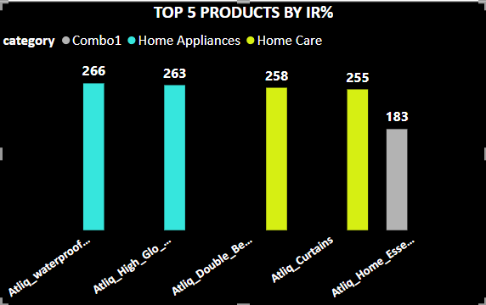
AD-HOC REQUESTS AND IT’S SOLUTIONS
BUSINESS REQUEST 5
QUESTION
Create a report featuring the Top 5 products, ranked by Incremental Revenue Percentage (IR%), across all campaigns. The report will provide essential information including product name, category, and IR%.
RESULT
This visualization enables us to pinpoint the products that experienced the most significant promotional impact. AtliQ's home appliances saw substantial revenue increases across both campaigns.
SQL QUERY
select product_name, category, round(((rap-rbp)/rbp)*100,2) as IR_perc from(select p.product_name,p.category, sum(base_price*quantity_sold_before_promo) as rbp, sum(base_price*quantity_sold_after_promo) as rap from fact_events f inner join dim_products p on f.product_code=p.product_code group by product_name,category) tt order by IR_perc desc limit 5;

Slide 13
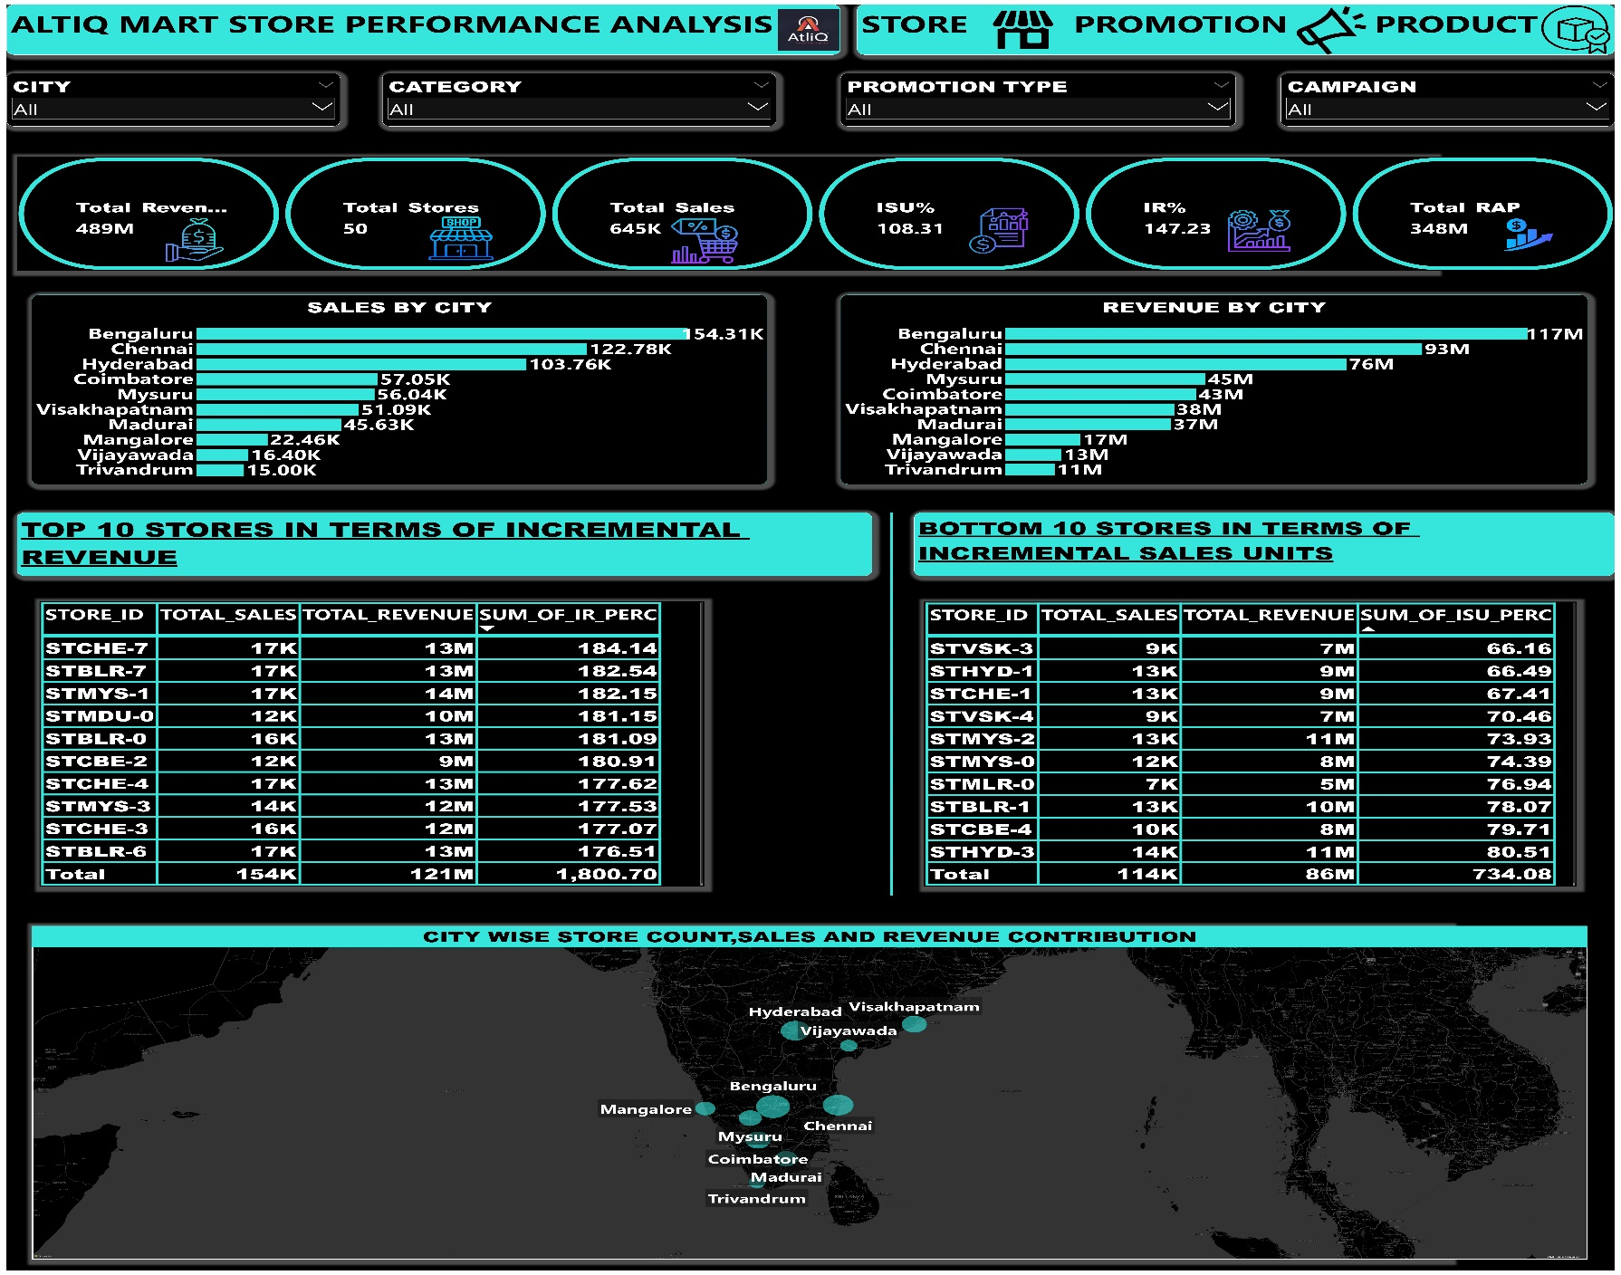
POWER BI DASHBOARD

Slide 14
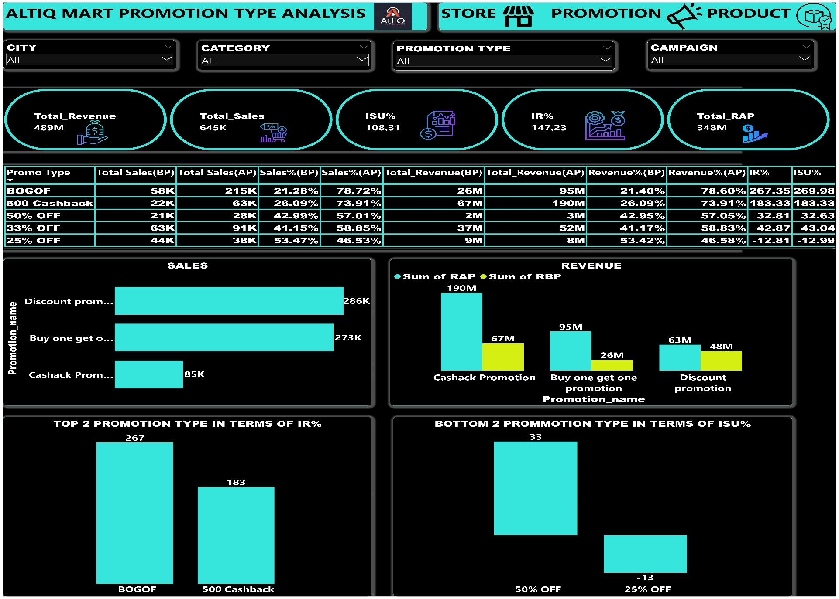
POWER BI DASHBOARD

Slide 15
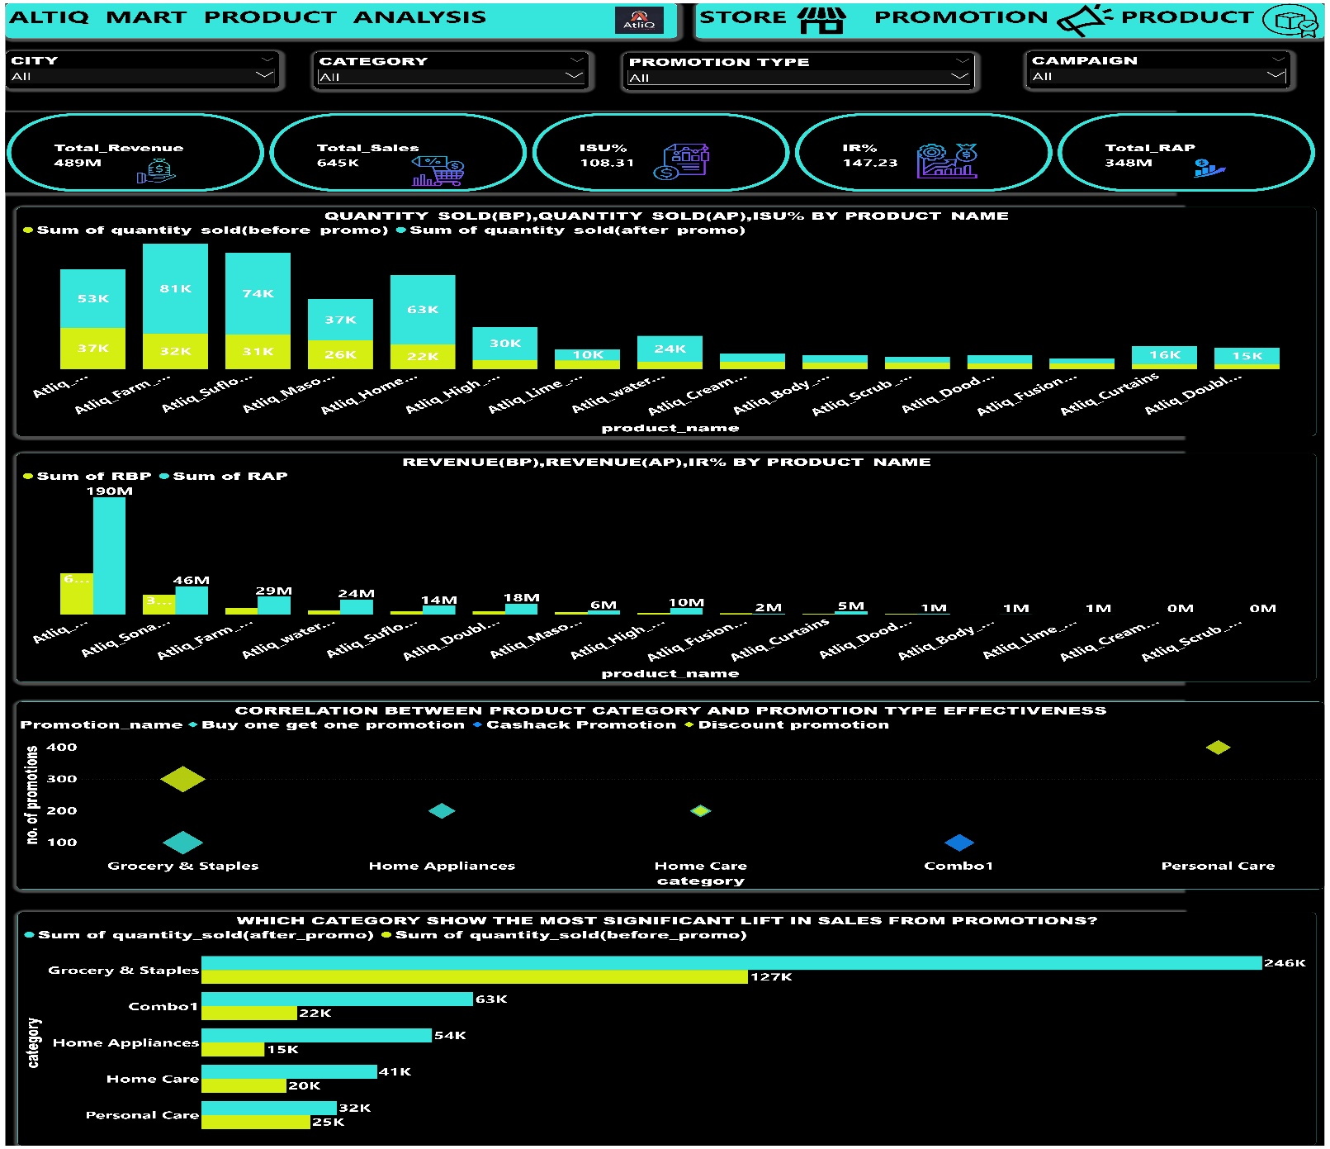
POWER BI DASHBOARD

Slide 16
INSIGHTS
Bengaluru, Chennai, and Hyderabad stand out as the leading cities in the southern region of India, boasting the highest number of stores, collectively representing 50% of the total stores in the region.
Moreover, the combined total sales and revenue from Bengaluru, Chennai, and Hyderabad contribute to over 58% of the overall sales and revenue in the southern region of India.
At AtliQ Mart, the Double Bed sheet Set and Waterproof Immersion Rod emerge as high-value products, priced at more than ₹ 1000/-, and are offered at significant discounts through 'BOGOF' promotions.
During the Diwali and Sankranti campaigns, there was a remarkable surge in revenue, with figures increasing by 151% and 141% respectively.
Notably, the Home Appliances and Combo1 categories experienced the highest ISU% (Increase in Sales Units) rates, reaching 244% and 202% respectively, during the Diwali campaign, indicating a substantial boost in sales.

Slide 17
RECOMMENDATIONS
The primary focus should be on optimizing retail operations in Bengaluru, Chennai, and Hyderabad to maximize profitability, alongside exploring expansion opportunities in other promising cities.
Given the substantial contribution from these top three cities, emphasis should be placed on customer engagement, retention strategies, and operational efficiency to further enhance sales and revenue.
To stimulate sales and attract customers, similar promotions should be extended to other high-value products besides the current offerings.
Investment in impactful promotional campaigns during festive seasons should continue, with thorough analysis of campaign strategies to replicate success in future campaigns.
Resources and marketing efforts should be allocated towards categories with higher ISU% to capitalize on seasonal demand and maximize incremental sales.

Slide 18
THANK YOU

